Slide 1
Advanced Machine Learning SDL Presentation Artificial Neural Networks (ANNs)
Presented by
230913003 Pasupuleti Rohithsaidatta
230913004 Amit Kumar
230913006 Chinmaya D Kamath

Slide 2
Content
Artificial Neural Networks (ANNs):
Perceptron Model
Activation Functions (e.g., sigmoid, ReLU, tanh)
Forward Propagation

Slide 3
Introduction to Perceptron
Perceptron: Simplest artificial neural network architecture
introduced by Frank Rosenblatt in the 1950s.
Structure: Consists of a single layer of input nodes fully connected to a layer of output nodes.
Neurons: Utilizes threshold logic units (TLUs), first introduced by McCulloch and Walter Pitts in the 1940s.

Slide 4
Introduction to Perceptron
Functionality: Perceptron can learn linearly separable patterns and serves as a binary classifier.
Learning Rule: Based on the original MCP neuron, the Perceptron learning rule enables neurons to learn and process elements in the training set one at a time.

Slide 5
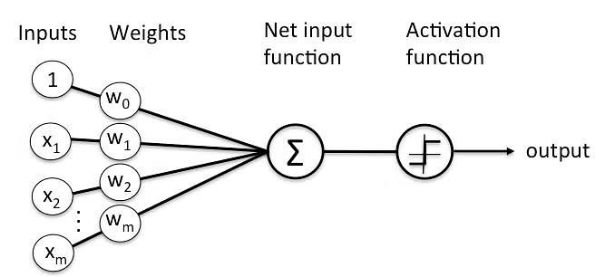
Introduction to Perceptron

Slide 6
Types of Perceptron
Single-Layer Perceptron: This type of perceptron is limited to learning linearly separable patterns. effective for tasks where the data can be divided into distinct categories through a straight line.
Multilayer Perceptron: Multilayer perceptrons possess enhanced processing capabilities as they consist of two or more layers, adept at handling more complex patterns and relationships within the data.

Slide 7
Basic Components of a Perceptron
Input Features: Represent characteristics or attributes of input data.
Weights: Associated with input features, determining their influence
on the perceptron's output.
Summation Function: Calculates the weighted sum of inputs.
Activation Function: Determines the output based on the weighted sum.
Output: Represents the final prediction or classification.
Bias: Additional parameter allowing adjustments independent of input.
Learning Algorithm: Updates weights and bias during training based on prediction errors.

Slide 8
How Perceptron Works
Input Features: Each input node is assigned a weight, indicating its significance.
Weighted Sum: Perceptron computes the weighted sum of inputs using the formula: z = w₁x₁ + w₂x₂ + ... + wₙxₙ.
Activation Function: Utilizes a step function (Heaviside step function) to determine output based on the weighted sum.
Fully Connected Layer: Each TLU in the perceptron's single layer is connected to all inputs.
Output Calculation: Output is calculated using the formula: f(X) = h(XW + b), where X is input, W is weight, b is bias, and h is step function.

Slide 9
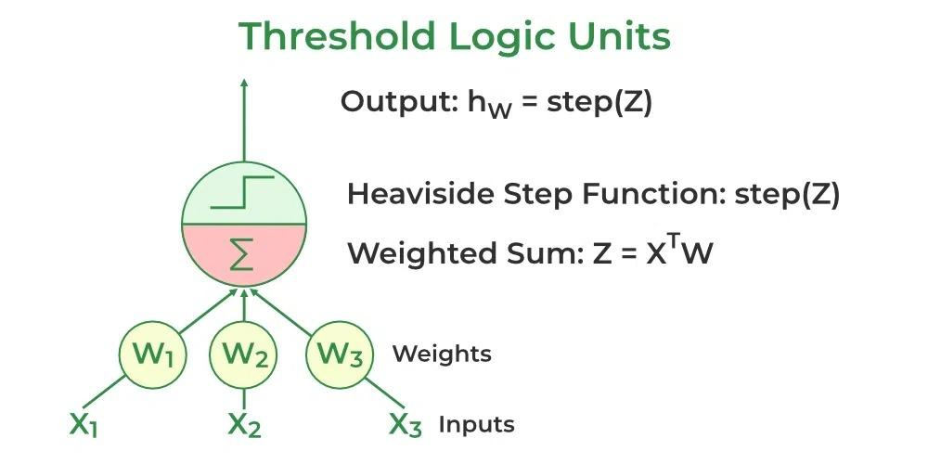

Training the Perceptron
Weight Adjustment: During training, weights are adjusted to minimize the difference between predicted and actual output.
Supervised Learning: Perceptron learning algorithms like the delta rule or perceptron learning rule are used.
Weight Update Rule: Example of weight update rule: wᵢⱼ = wᵢⱼ + η(yⱼ - ŷⱼ)xᵢ, where wᵢⱼ is weight, xᵢ is input value, yⱼ and ŷⱼ are actual and predicted values, and η is the learning rate

Slide 10
Implementation
Build the single Layer Perceptron Model
Initialize the weight and learning rate, Here we are considering the weight values number of input + 1. i.e +1 for bias.
Define the first linear layer Define the activation function. Here we are using the Heaviside Step function.
Define the Prediction.
Define the loss function.
Define training, in which weight and bias are updated accordingly.define fitting the model.

Slide 11
Implementation
Apply the above-defined model for binary classification of the Breast
Cancer Dataset
import the necessary libraries
Load the dataset
Assign the input features to x
Assign the target features to y
Initialize the Perceptron with the appropriate number of inputs
Train the model
Predict from the test dataset
Find the accuracy of the model

Slide 12
Characteristics of the Perceptron Model
The following are the characteristics of a Perceptron Model:
It is a machine learning algorithm that uses supervised learning of binary classifiers.
In Perceptron, the weight coefficient is automatically learned. Initially, weights are multiplied with input features, and then the decision is made whether the neuron is fired or not.

Slide 13
Characteristics of the Perceptron Model
The activation function applies a step rule to check whether the function is more significant than zero.
The linear decision boundary is drawn, enabling the distinction between the two linearly separable classes +1 and -1.
If the added sum of all input values is more than the threshold value, it must have an output signal; otherwise, no output will be shown.

Slide 14
Advantages and Disadvantages
Advantages:
A multi-layered perceptron model can solve complex non-linear problems.
It works well with both small and large input data.
Helps us to obtain quick predictions after the training.
Helps us obtain the same accuracy ratio with big and small data.

Slide 15
Advantages and Disadvantages
Disadvantages:
In multi-layered perceptron model, computations are time-consuming and complex.
It is tough to predict how much the dependent variable affects each independent variable.
The model functioning depends on the quality of training.

Slide 16
Limitation of Perceptron Model
The following are the limitation of a Perceptron model:
The output of a perceptron can only be a binary number (0 or 1) due to the hard-edge transfer function.
It can only be used to classify the linearly separable sets of input vectors. If the input vectors are non-linear, it is not easy to classify them correctly.

Slide 17
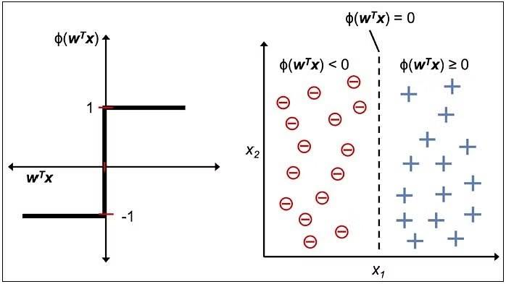
Decision function

Slide 18
Activation Function
Activation functions are critical components of artificial neural networks, particularly in deep learning architectures.
They introduce non-linearities into the network, enabling it to learn complex mappings between inputs and outputs.

Slide 19
Why Use Activation Functions
Introduction of Non-Linearity: Without activation functions, the neural network would reduce to linear model. Activation functions enable the neural network to learn complex, non-linear relationships between inputs and outputs.
Enabling complex representations: Learn and represent complex features and patterns in the data. Neural networks can capture intricate relationships and hierarchical structures within the data, enabling them to learn increasingly abstract and sophisticated representations.
Addressing the vanishing gradient problem: Activation functions play a crucial role in mitigating the vanishing gradient problem, which arises during backpropagation in deep neural networks. In deep networks, gradients can become extremely small as they are propagated backward through many layers, leading to slow or stagnant learning.
Controlling Neuron Activation: Activation functions determine the output of individual neurons in the network based on their input.
Adding Bias: Activation functions can introduce bias into the network's output, enabling it to learn and represent certain types of data distributions more effectively.

Slide 20
Types of Activation Functions
Sigmoid Function(Logistic)
Hyperbolic Tangent Function
Rectified Linear Unit(ReLU)
SoftMax

Slide 21
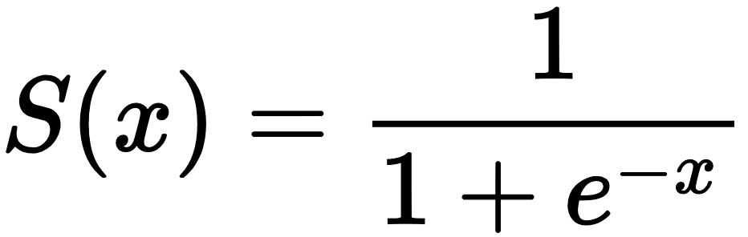
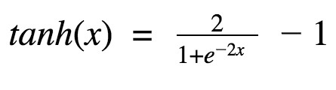
Sigmoid Function
Tangent Hyperbolic Function
Nature: Non-linear
X values between -2 to 2 produce steep changes in Y.
Small changes in X lead to large changes in Y.
Value Range: 0 to 1
Typically employed in the output layer of binary classification tasks.
Predictions lie between 0 and 1, facilitating easy classification based on threshold (e.g., 0.5).
Nature: Non-linear
Mathematically shifted version of the sigmoid function.
Values range from -1 to +1.
Typically utilized in hidden layers of neural networks.
Centering the data: Mean of tanh activations in hidden layers is close to 0, aiding in data normalization and facilitating easier learning in subsequent layers.

Slide 22
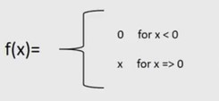
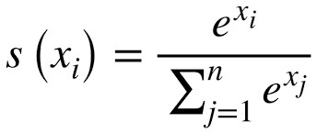
Rectified Linear Unit
SoftMax Function
Nature: Non-linear
Outputs the input if positive, otherwise outputs 0.
Value range: [0, ∞)
Primarily implemented in hidden layers of neural networks.
Faster learning compared to sigmoid and tanh due to its non-saturating nature.
Less computationally expensive than sigmoid and tanh, contributing to faster training.
Nature: Non-linear
Primarily employed in the output layer of classifiers handling multiple classes.
Squeezes outputs for each class between 0 and 1.
Divides outputs by the sum of all outputs to attain probabilities for each class.
Ideal for multi-class classification tasks where probabilities of different classes need to be determined.
Provides probabilities defining the likelihood of each input belonging to various classes.

Slide 23
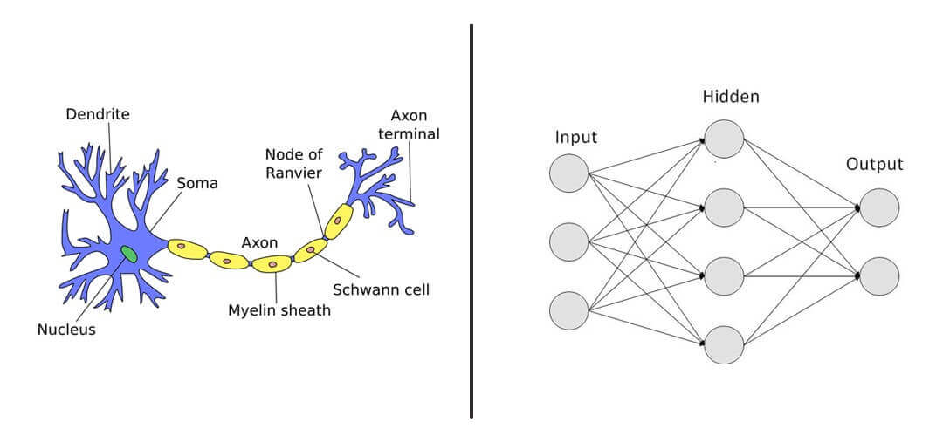
Introduction to Neural Networks
Inspired by the human brain's structure.
Made of interconnected nodes called neurons in layers.
Used for pattern recognition, classification, regression, etc.
Mimics human brain's functioning for computational tasks.

Slide 24
How Neural Networks Work
Input data flows through weighted calculations and activations.
Neurons process input and pass output to the next layer.
Adjusts weights and biases through backpropagation for learning.
Learns complex, non-linear relationships autonomously.

Slide 25
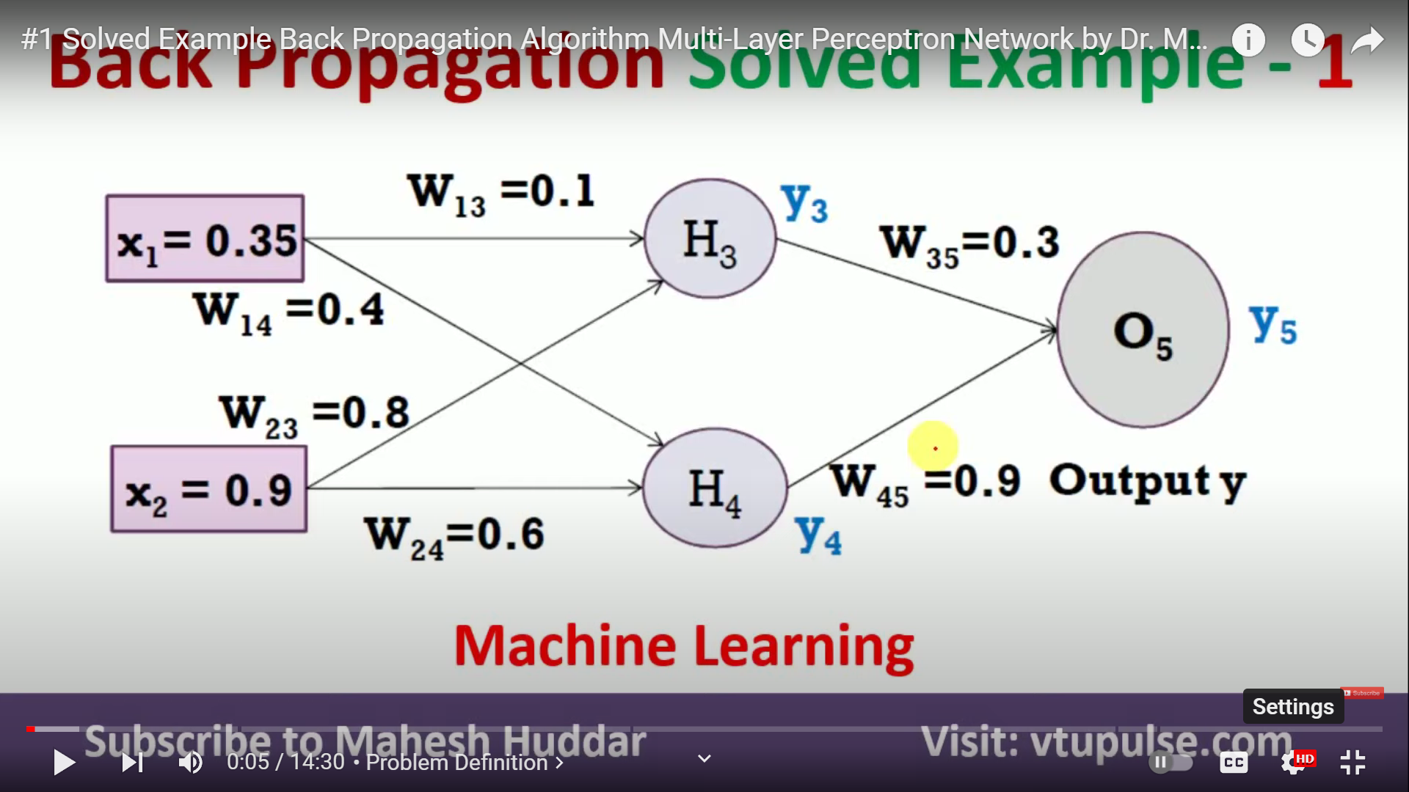
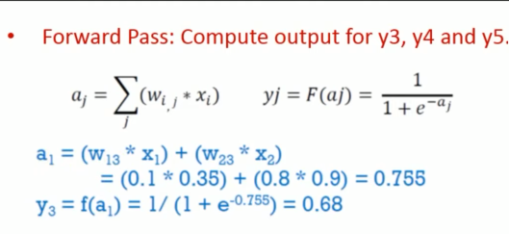
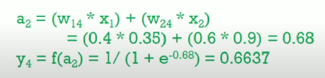
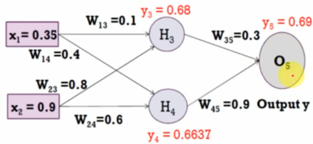
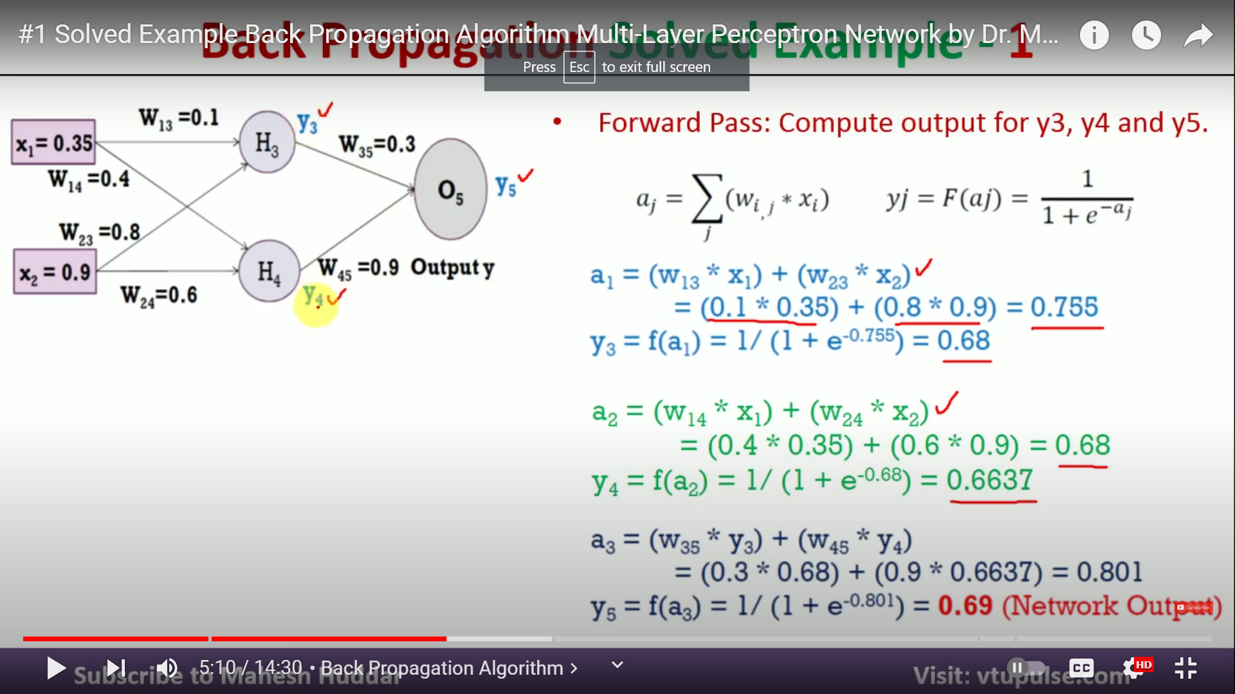
Forward Propagation

Slide 26
Thank You ☺

